Slide 1

Title page

Slide 2
Introduction: What? Why?

Slide 3
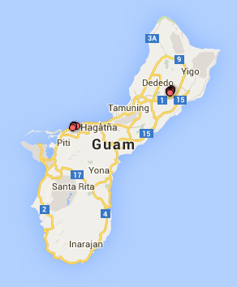
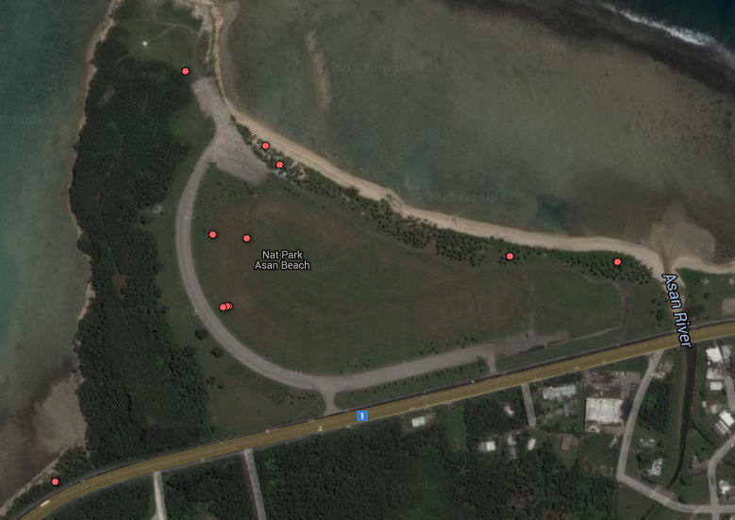
Where?
Location: Asan Beach Park.
Notes:
Roughly triangular with ocean on one side, forest on another, wetlands on the third, and grassy fields in the middle

Slide 4
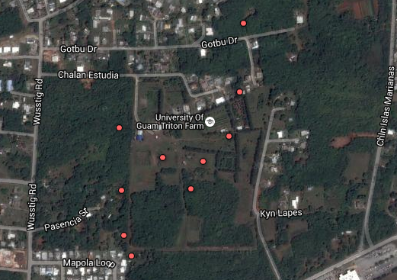
Where?
Location: Triton Farm University of Guam Research Station.
Notes:
Farmland including some brushy forest as well as open fields bordered by residential area.

Slide 5

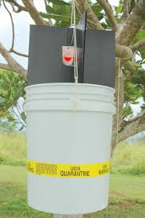
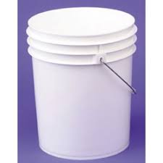

How? Step 1: Get beetles for experimentation
Orytcylure
First: Catch beetles
Next: flight testing
Notes:
Next: Test beetles to see if they can fly. Put beetles in dog bowl on top of bucket inside the trash can. If they fly out, they fall into the bottom of the trash can

Slide 6
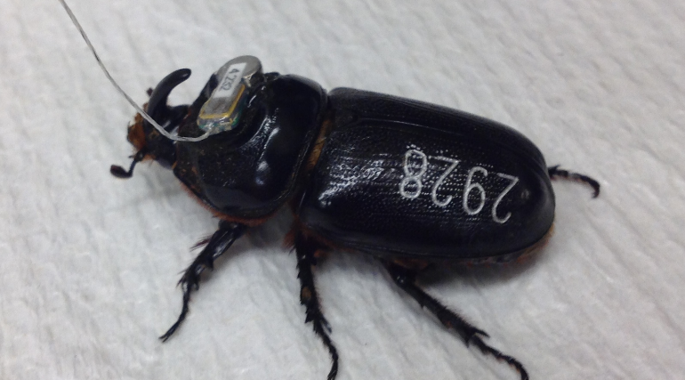
How? Step 3: Record beetle data and attach transmitters
Give beetles ID numbers and record mass, sex, and elytra dimensions.
Unique ID number engraved on elytra with a high power laser

Slide 7
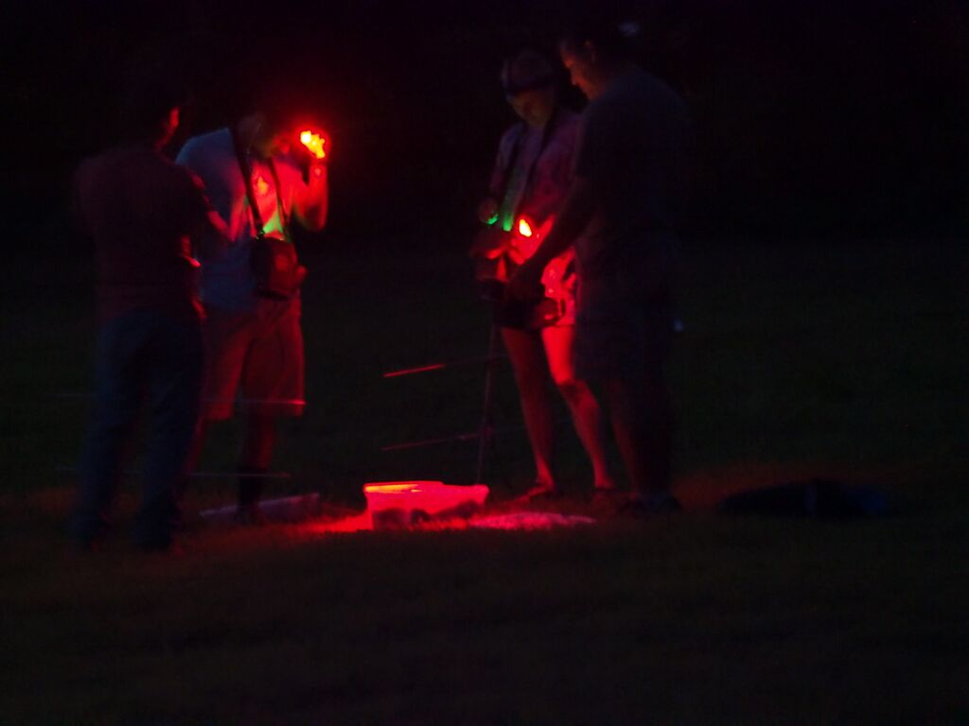
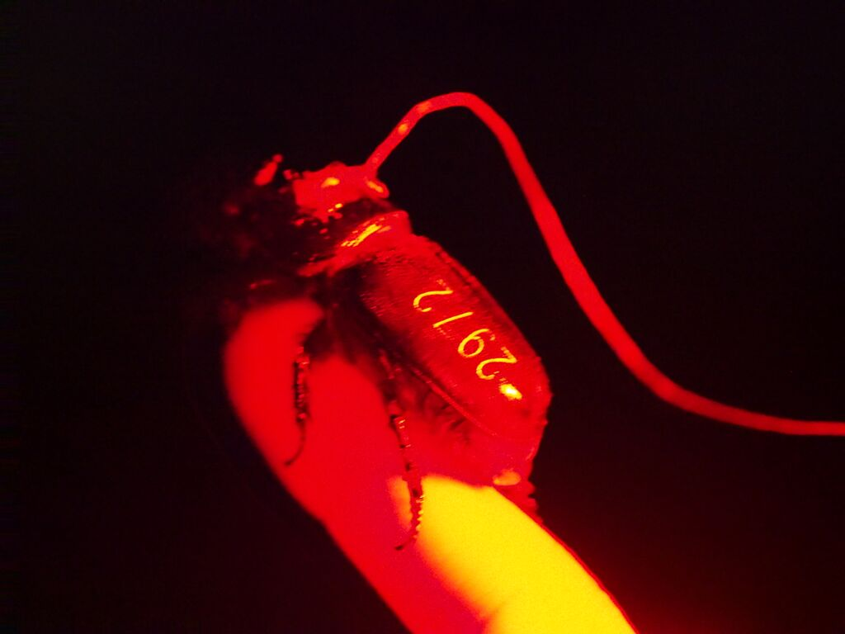
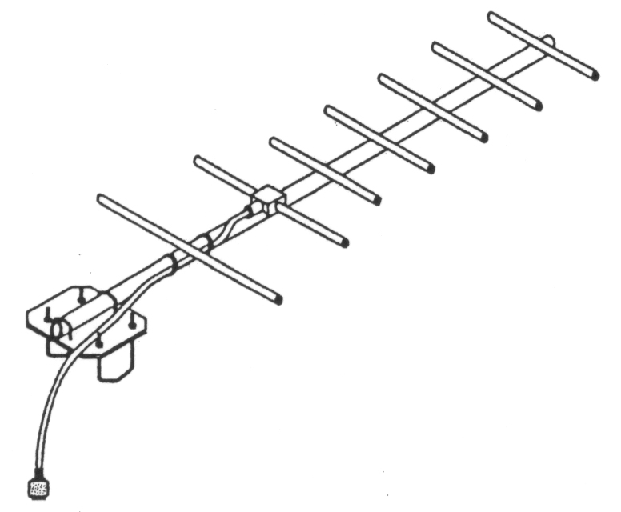
How? Step 3.) Release!!!
Let the chase begin!
Notes:
Released at night
Each person equipped with Yagi receiver and GPS unit
Watched beetles with an infrared camera to see if they were warming up
Let them take off, record starting location.

Slide 8
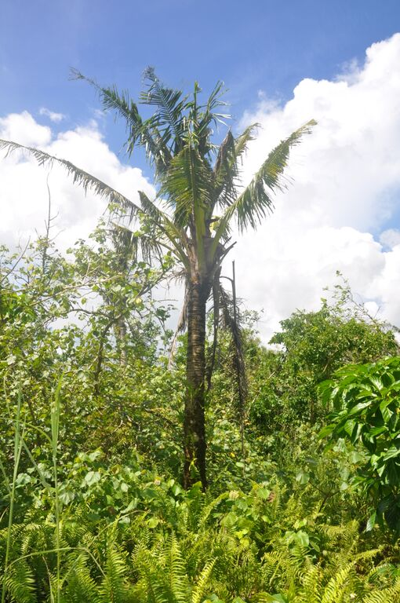
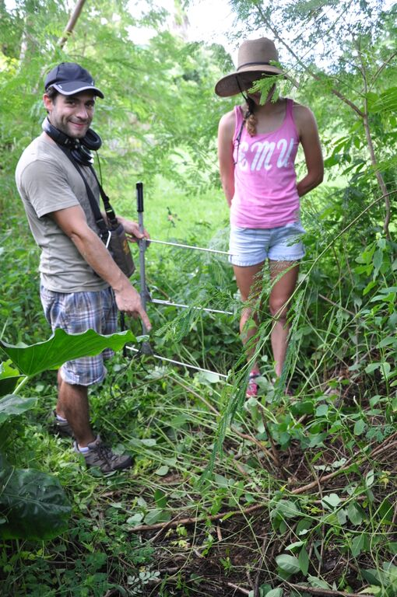
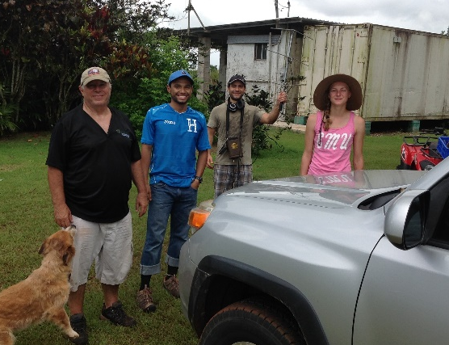
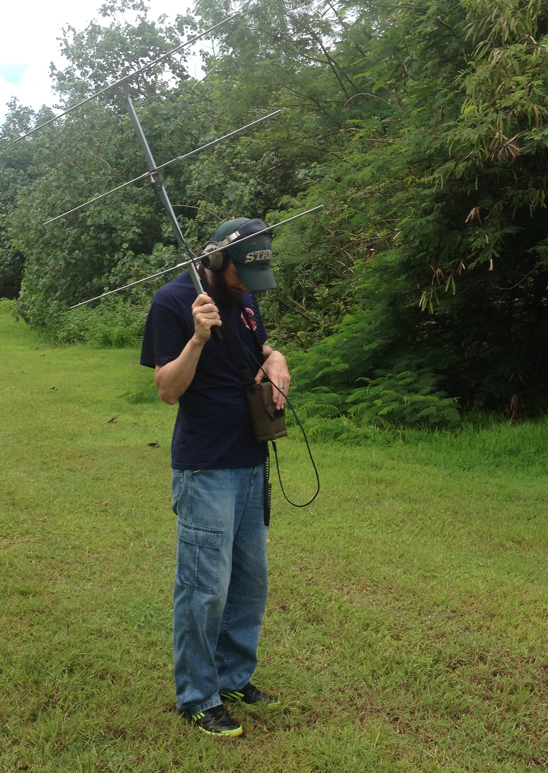
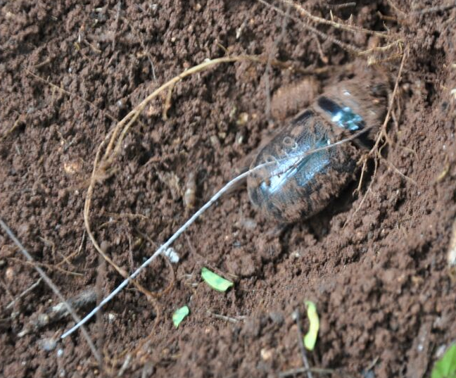
How? Step 4.)Follow up
After locating beetle and recording location at night, return during daylight to recover beetles.

